Slide 1
Screenless Video & Displays
Elsie Hubrich

Slide 2

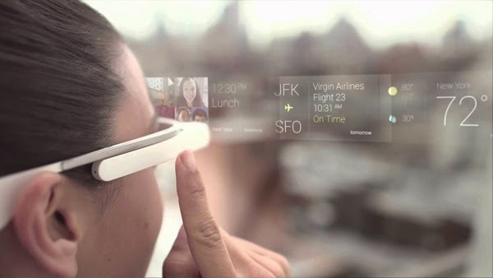
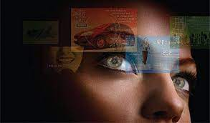
Overview
History
Plan & Implementation
Upsides/Pros
Downsides/Cons
Summary
References

Slide 3
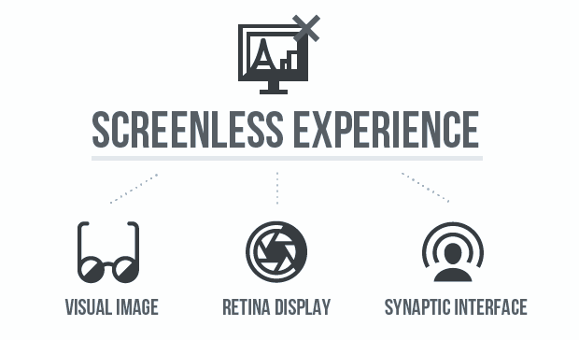
History - Who & when it was conceived?
There are three main groups of screenless displays
They are: Visual Image, Retinal Direct, and Synaptic Interface
The VRD (Virtual Retina Display) was originally invented by Kazuo Yoshinaka in 1986
In 1991, a VRD system was brought out by the Human Interface Technology Lab at the University of Washington
The VRD is currently undergoing more research
Google Glasses are the first technology similar to screenless display
The market for screenless displays is expected to rise quickly between 2023 -2030
Notes:
The types of screenless displays:
Visual Image is typically the most common form of screenless display, where the video is displayed on air. Light is usually projected onto an object or surface before it becomes visible to viewers, but Visual Image removes the intermediate object from the process. Some of the most common examples of Visual Image include Virtual Reality goggles, Holograms, and Heads-up Display in airplanes and cars.
Retinal Display technology projects images directly into the retina of the viewer’s eyes. There is no screen or source of deflection or reflection. You are the only person who will be able to see the videos, since it only reaches your retina. This is very useful when you need to keep something private or secure.
Synaptic Interface is similar to Retinal Display as it includes the images directly reaching the viewer. However, the difference is that the images now reach the viewer’s brain instead of their retina. This is done my transmitting information directly to the brain. It is very helpful for people who are blind or visually impaired.
More about VRD Displays:
Virtual Retinal Display (VRD) is a type of screenless Retinal Display. In VRD, no real image is produced, it beams the light onto our eyes directly, and our brain translates it from there. It gives the user the sense that the display is floating in space in front of them. Other common names for it include Retinal Scan Display and Retinal Projector. While there are some VRD systems out there already, it is still undergoing more research and development.
Google Glasses, also known as Google Glass, is an example of an Augmented Reality device (a technology that projects an image into a user’s field of view of the real world). They look like a small pair of glasses or frames with a small, transparent display above the right eye. The main purpose of them is to provide users with hands-free access to digital information. They include a camera, microphone, touchpad, and a speaker that uses vibrations transmitted into the user’s skull to provide audio. However, the sale of Google Glass stopped in 2023 due to privacy concerns.

Slide 4
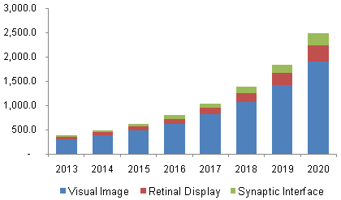
Plan & Implementation - Who or what it will impact?
Screenless displays are expected to be one of the greatest technological advances in the coming years
Visual Image technology is the most popular
It has undergone the most advancements so far
The Global Screenless Display Market is expected to grow significantly in the next decade
The North America, Europe and Asia-Pacific areas are the most involved
Notes:
Summary:
Screenless display is one of the current evolving technologies relating to computer-enhanced technology. It is going to be one of the greatest technological developments in the coming years. Visual Image technology is the most popular/advanced of the three groups, with Retinal Display following and Synaptic Interface in last.
The Global Screenless Display Market:
Different sources state that the GSDM reached between 1.6 to 3.9 billion from 2022 to 2023. It is expected to rise by 23.4% to 35.43% (a common percentage stated is 31.2%) in the next decade or so.

Slide 5
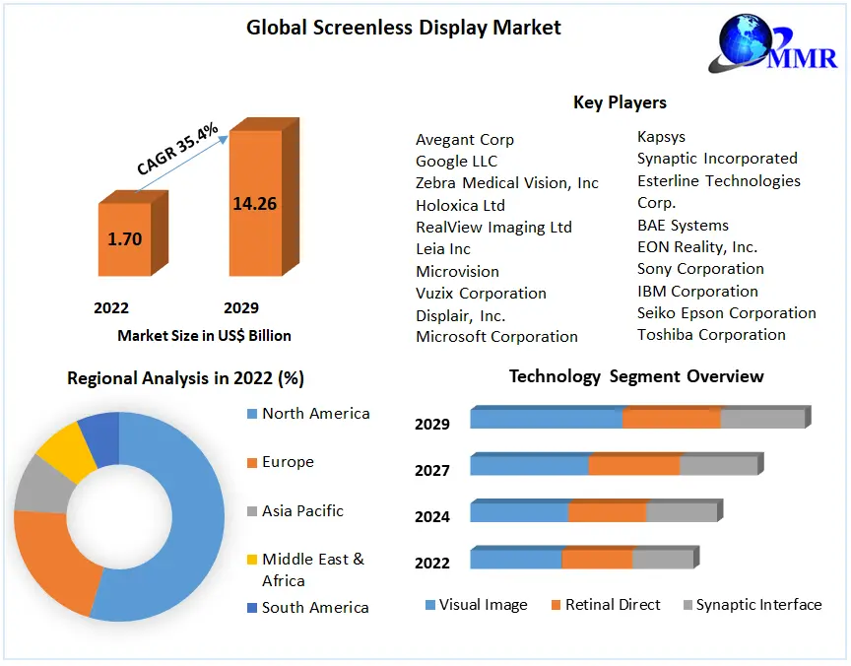
Stats for the Global Screenless Display Market in the coming years
Notes:
Explanation of Stats:
There is an expected increase of 35.4% in the GSDM from 2022 to 2029
North America is the most prominently involved in the market, with Europe in second
There are multiple important people and companies involved in the development, research and selling of screenless displays
Visual Image technology is the most developed/researched, then Retinal Direct, then Synaptic Interface

Slide 6
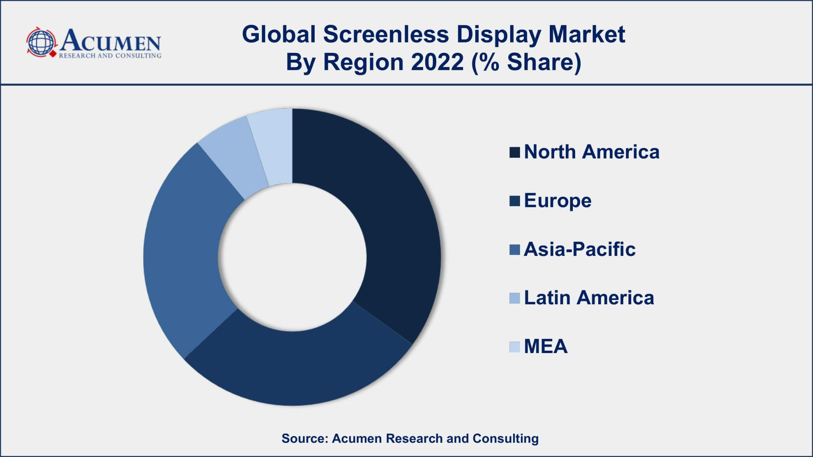
Screenless displays will have an effect on many different people, groups and companies
Users will experience a seamless integration between digital and physical environments
A broader group of people will be able to access digital information
Manufacturing of physical screens will decrease
Education can be changed to include immersive and interactive learning experiences
Gaming and entertainment industries will be enhanced
Communication with others will become easier
Notes:
The introduction of screenless displays, especially into our daily lives, presents the possibility of changing the way we interact with digital information and the physical world.
Enhanced user experience: They can provide a more immersive and intuitive experience because they do not rely on ‘traditional’ screens.
Improved accessibility: By using technologies like audio cues, haptic feedback (using physical stimuli to communicate things, like when your phone buzzes with a notification), and gesture recognition, a wider range of people will be able to access digital information.
Disruption of traditional display technologies: There may be a shift away from displays such as TVs, computer monitors, and smartphones. This reduces the need for physical screens.
Students can visualize concepts in 3D, explore virtual environments, and engage in hands-on simulations. This helps with understanding, retention and student engagement.
Entertainment and Gaming: Augmented reality experiences can help create more immersive and interactive gaming experiences. This could blur the lines between digital and physical environments.
Communication and Collaboration: More natural and immersive places to communicate will be created. Virtual meetings can be held easily. Collaboration tools can help users work with others in real-time, which improves productivity and teamwork.

Slide 7
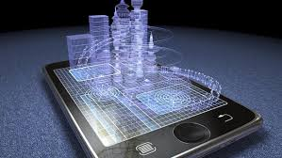
Ads, marketing and shopping will be able to be done virtually
Travel and navigation will improve with hands-free directions being given
New expression of art and design will be inspired
Broader social changes would occur
Social interactions may be different as people use technology more and more often
Access to screenless technology may vary among different groups, growing the ‘digital divide’
The environment will improve with less resources being taken from it
Notes:
Advertising and Marketing: Augmented reality can create interactive and personalized advertisement experiences. (eg. users can virtually try on clothes or picture how furniture looks in their house) Ads can be integrated into the physical environment, giving the opportunity for targeted and context-aware marketing.
Travel and Navigation: Specifically helpful in unfamiliar places, screenless displays can provide real-time information and directions directly in the user’s field of view. This reduces the issues of people looking at their phones while driving.
Art and Design: Artists can create immersive installations that blend physical and digital elements, creating unique, interactive experiences. Designers can use screenless displays to digitally visualize how things look and interact in the physical world.
Social Impact: Similar to the divide between those with lots of wealth and those in poverty, the introduction of technology like screenless displays could create another gap between those who have access to them and those who do not.
If built correctly, screenless displays have the potential to use a lot less power than traditional screens. This benefits both the environment and users themselves, as less power means lower costs.

Slide 8
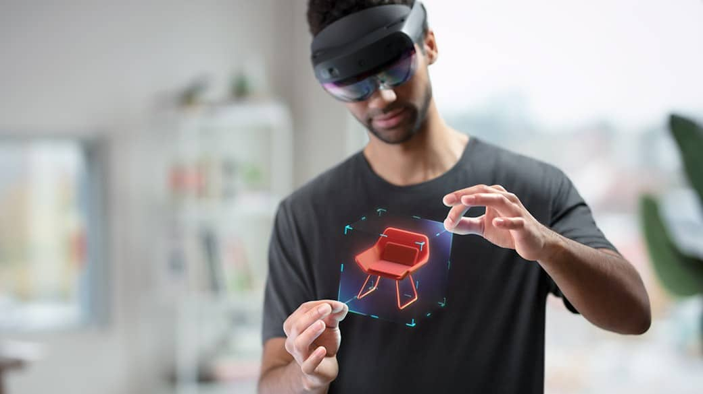
Upsides/Pros of the development
Less likely to break or be damaged
Energy use is reduced
Wider angle of view, higher resolution of images, more accurate colors
More flexibility in design
An expanse of information that is easily and quickly accessible
Notes:
If built carefully and specifically, screenless displays could have a lot of benefits for both individuals and communities. They provide a whole new realm of opportunities and tools, which, if used correctly, can do and create incredible things. Here are some of the pros that could occur:

Slide 9
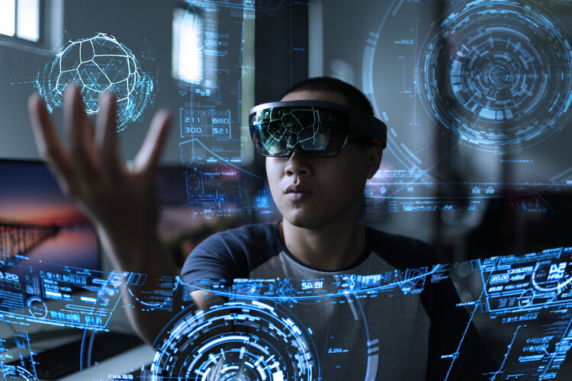
Improved accessibility for a wider range of people
Enhanced/realistic experience for users
Augmented reality changes the viewer’s perception and interaction of their surroundings
Easy access to amenities like shopping, research, news, broadcasts and other services
Increased resources for creating art and design
Hands-free and easy to use
Increased privacy and security
Provides a new, unique and exciting experience

Slide 10
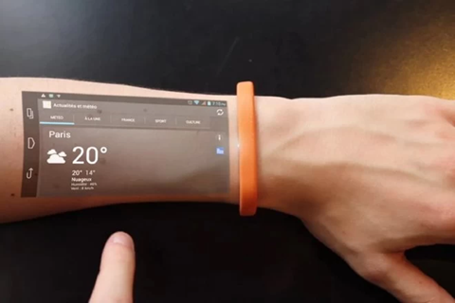
Downsides/Cons of the development
Risk of increased dependence on technology
Ethical issues with privacy and security
Not currently available in large quantities
At the present time, quite expensive
Limited display area
Visual discomfort and tiredness
Social disconnection
Notes:
While there are many possible upsides of the introduction of screenless displays, there are also potential consequences or downsides. These range from simple things like comfortability and price to becoming an issue when driving or in public. Here are some of the cons that could occur:

Slide 11

Difficult to adapt to using them in our daily lives
Different types may not be compatible
Driving while using screens is dangerous
No control over what is displayed by others in public
Bulky technology (in its first stages)
Possible health and vision problems
Difficult to control unless done in a specific way
Specific adjustments needed for different individuals
Unstable/unproven technology
Long training time to learn how to use

Slide 12


Summary
I believe that the introduction of screenless displays into society is inevitable. However, I am all for delaying this as long as possible. While the things we would be able to do with them are fascinating and enticing, I do not like the idea of constantly looking at a screen. Even today, people are entranced by their devices. Imagine what would happen if they were being displayed without a physical object. People would hardly ever stop to experience the real world. This is why I believe while there are many advantages and benefits of screenless displays, it is not a technology that I want to be put out into the world.

Slide 13
References
A Report on Screenless Display
Screenless Display Technology: Everything You Need to Know
Google Glass: Reading Your Mind With The Help Of A New App
Screenless Displays âˆ’The Emerging Computer Technology
Screens: From Materiality to Spectatorship – A Historical and Theoretical Reassessment
Screenless Display
Screenless Displays are the user interface of the future
The Rise of Screenless Computing: A Glimpse into a Future Without Screens
Future Towards Screenless Innovation
Introduction to Screenless Displays and their Types
Screenless Display
Screenless Display Market Size Predictions
Screenless Display Contents

